Slide 1

20. Mental Health
Session V: Mental and Physical Health

Slide 2
Chapter outlines
4. Eating Disorders
5. Anxiety Disorders
6. Suicidal Behavior

Slide 3
LEARNING OBJECTIVES
By the end of this section, you will be able to:
Identify the difference between occasional negative emotions and more serious mental health issues, such as anxiety disorder or depression
Explore practices for ensuring mental health and emotional balance in your life
Identify resources for further information and guidance about mental health issues

Slide 4
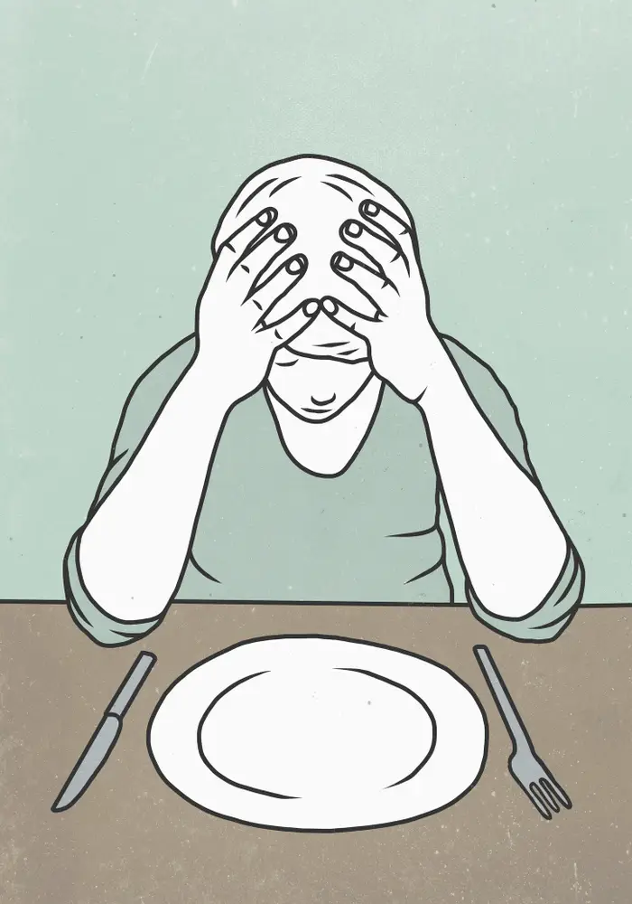
4. Eating Disorders
Eating disorders are mental health illnesses
that involve emotional and behavioral disturbance surrounding weight and food issues.
The most common are anorexia nervosa, bulimia nervosa, and binge eating disorder.
Eating disorders can have life-threatening consequences.

Slide 5

4.1 Anorexia nervosa
Is characterized by self-starvation and extreme weight loss either through restriction or through binge-purging.
May frequently be:
A result of body dysmorphic disorder
or a result of other psychiatric complications

Slide 6
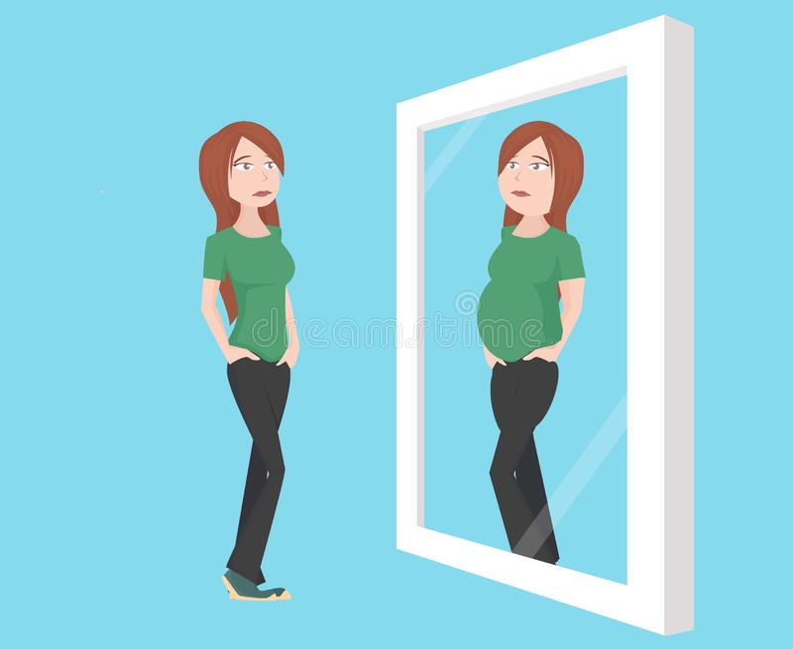
Affects
Starvation can cause harm to vital organs such as:
The heart and brain
Nails, hair, and bones to become brittle
Make the skin dry and sometimes yellow or covered with soft hair.
Menstrual periods can become irregular or stop completely.

Slide 7
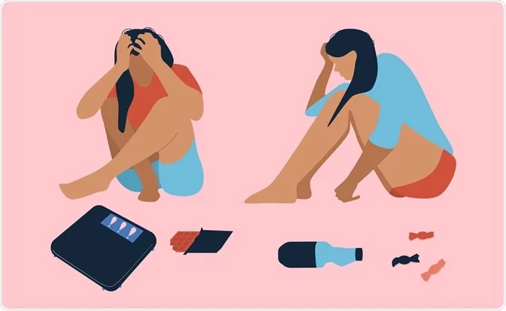
4.2 Bulimia nervosa
People with bulimia nervosa eat large amounts of food (also called bingeing) at least two times a week and then vomit (also called purging) or exercise compulsively.

Slide 8
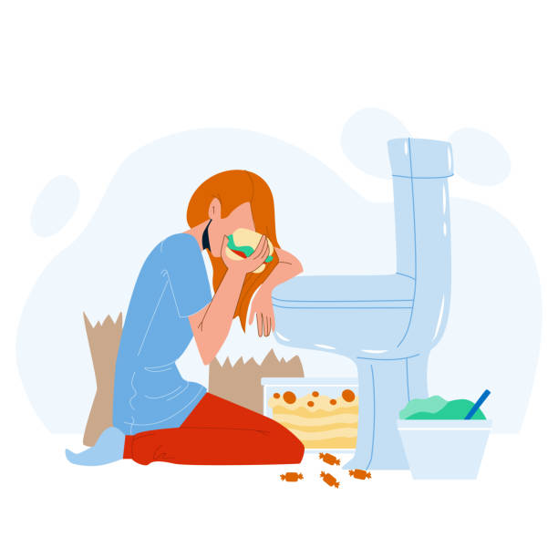
Affects
Vomiting can cause:
Loss of important minerals
Life-threatening heart arrhythmia (irregular heartbeat)
Damage to the teeth, and swelling of the throat.
Bulimia can also cause irregular menstrual periods.

Slide 9

4.3 Binge eating disorder
This is frequently associated with feelings of loss of control and shame surrounding eating.

Slide 10
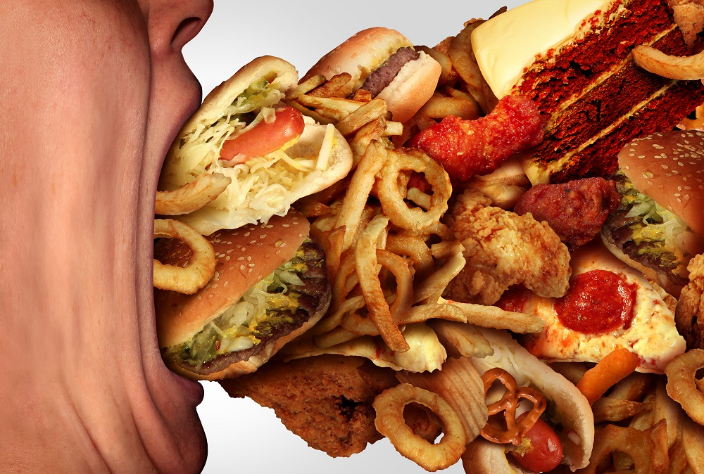
Affects
People who are diagnosed with this disorder tend to gain weight, and many will have all of the consequences of being overweight.
Including: high blood pressure and other cardiac symptoms, diabetes, and musculoskeletal complaints.

Slide 11

If you think you might have an eating disorder, you should go to the student health center or counseling center and get help.
Talk with your family and close friends.

Slide 12
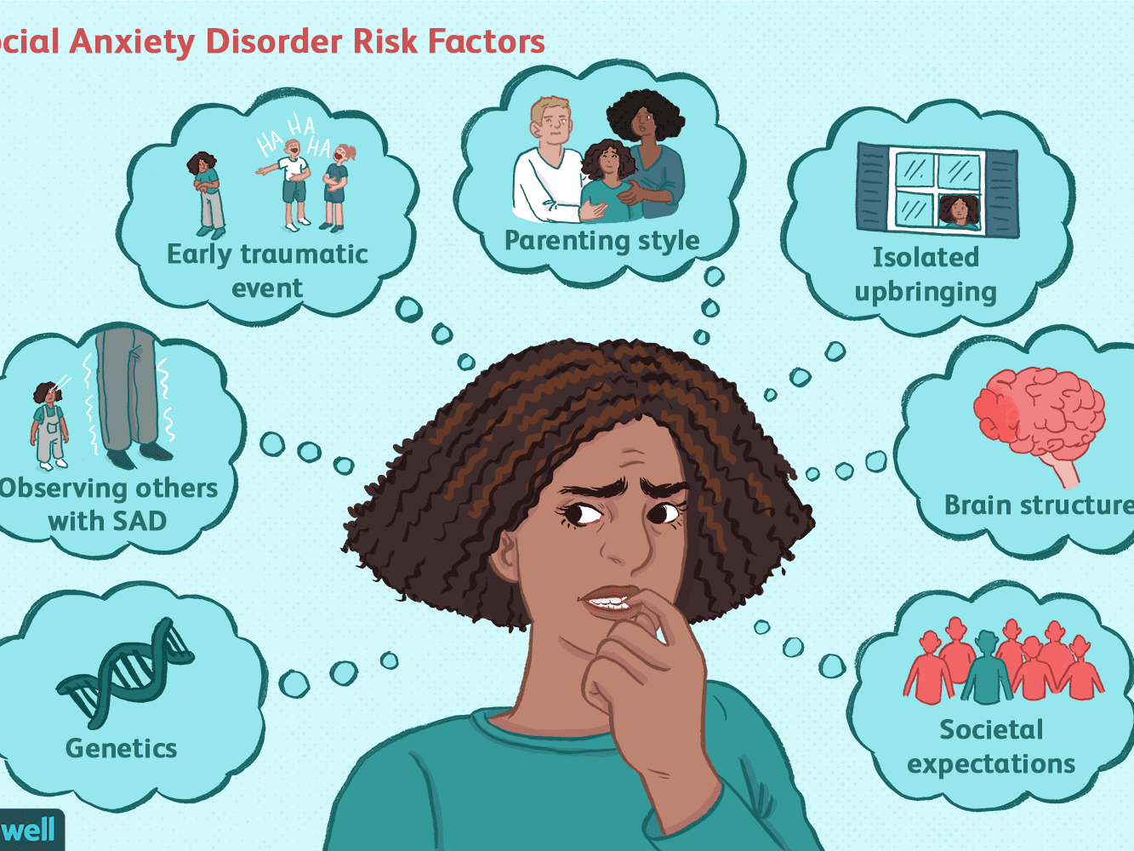
5. Anxiety Disorders
People with anxiety disorders respond to certain objects or situations with fear and dread.

Slide 13
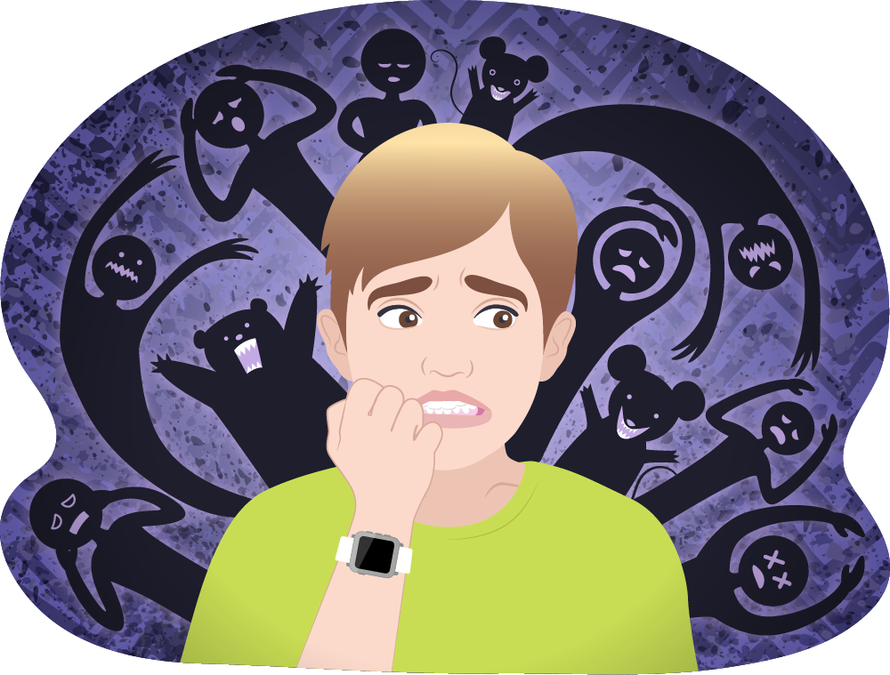
An anxiety disorder is diagnosed if a person:
Has an inappropriate response to a situation
Cannot control the response
Has an altered way of life due to the anxiety

Slide 14
Anxiety disorders include the following:
Obsessive-compulsive disorder (OCD)
Panic disorder
Phobia
Post-traumatic stress disorder (PTSD)

Slide 15
5.1 Obsessive-compulsive disorder (OCD)
Is a type of anxiety disorder. If you have OCD, you have repeated, upsetting thoughts called obsessions. You do the same thing over and over again to try to make the thoughts go away.
Those repeated actions are called compulsions.
Examples of obsessions are a fear of germs or a fear of being hurt.
Researchers think brain circuits may not work properly in people who have OCD.
It tends to run in families.
The symptoms often begin in children or teens.
Treatments that combine medicines and therapy are often effective.

Slide 16
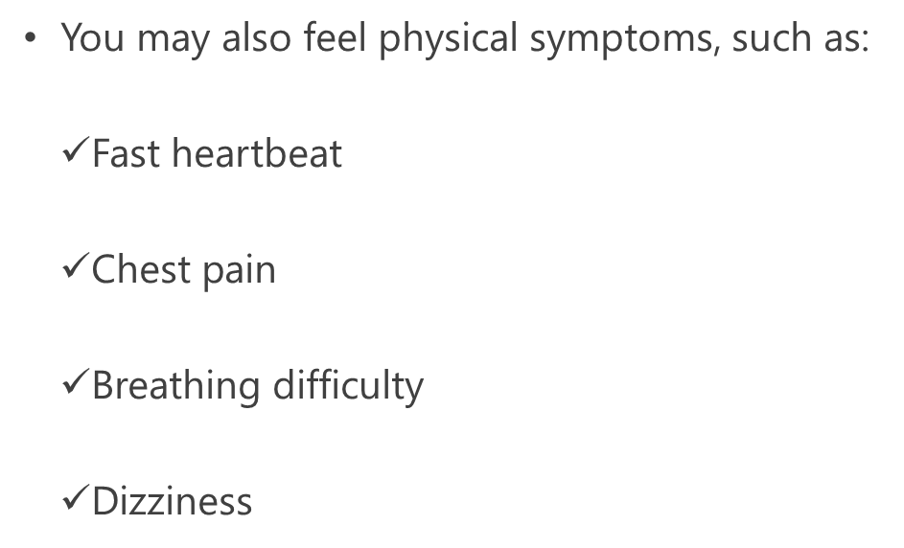
5.2 Panic disorder
Is a kind of anxiety disorder that causes panic attacks.
Panic attacks are sudden feelings of terror for no reason

Slide 17
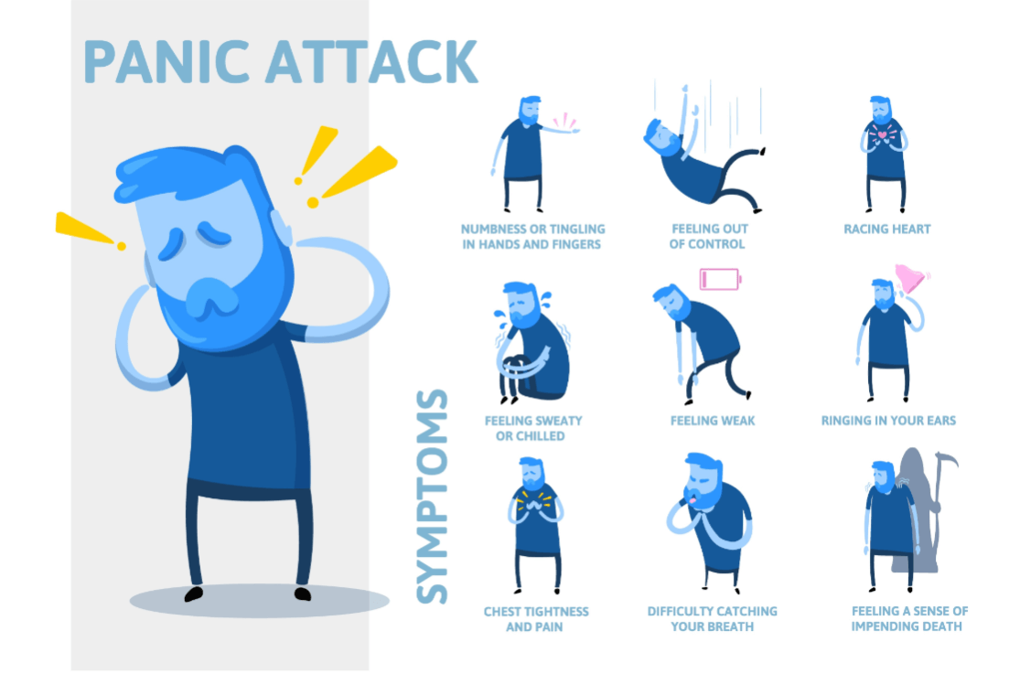
Panic attacks can happen anytime, anywhere and without warning
You may live in fear of another attack and may avoid places where you have had an attack.
Panic disorder is more common in women than men. It usually starts when people are young adults. Sometimes it starts when a person is under a lot of stress.
Therapy can show you how to recognize and change your thinking patterns before they lead to panic.
Medicines can also help.

Slide 18

5.3 A phobia
Is a strong, irrational fear of something that poses little or no actual danger.
Example: Acrophobia is a fear of heights.

Slide 19
People with phobias try to avoid what they are afraid of. If they cannot, they may experience:
Panic and fear
Rapid heartbeat
Shortness of breath
Trembling
A strong desire to get away
Treatment helps most people with phobias. Options include medicines, therapy or both.

Slide 20
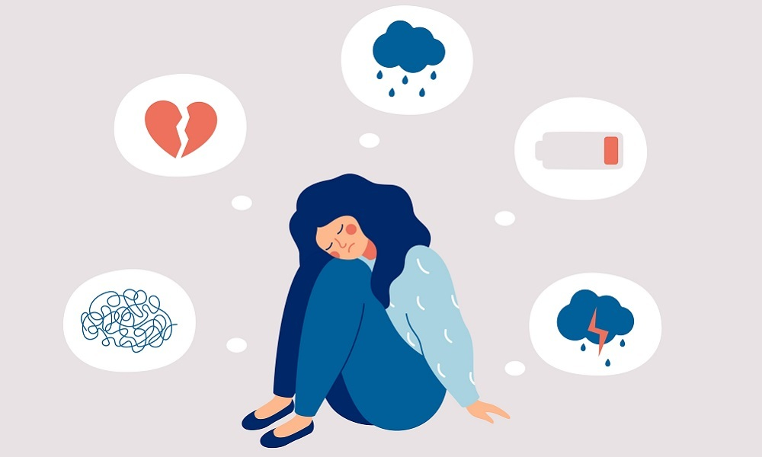
5.4 Post-traumatic stress disorder (PTSD)
Is a real illness.
You can get PTSD after living through or witnessing a traumatic event, such as war, a hurricane, rape, physical abuse, or a bad accident.

Slide 21
PTSD makes you feel stressed and afraid after the danger is over. It affects your life and the people around you.
PTSD can cause problems like:
Flashbacks, or feeling like the event is happening again
Trouble sleeping or nightmares
Feeling alone
Angry outbursts
Feeling worried, guilty, or sad

Slide 22
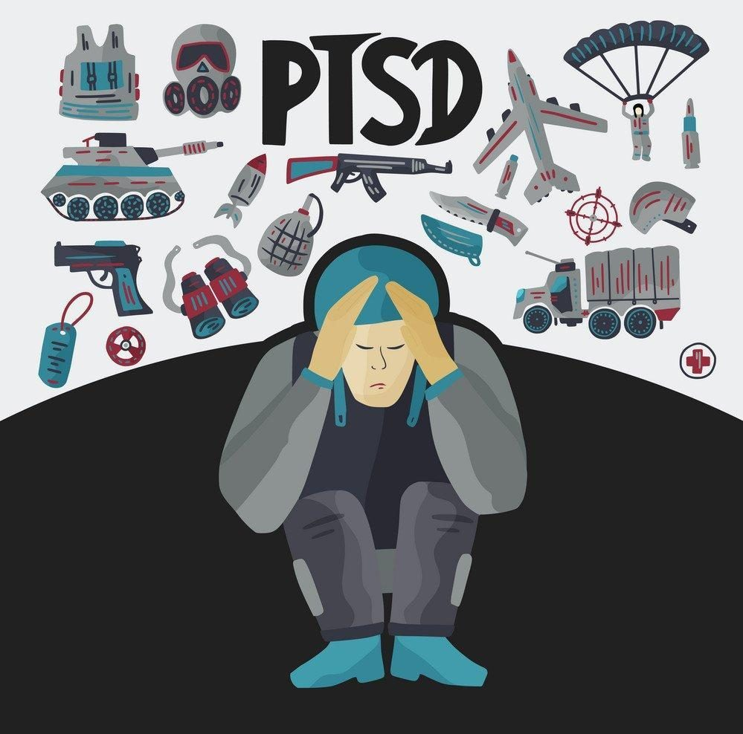
PTSD starts at different times for different people. Signs of PTSD may start soon after a frightening event and then continue. Other people develop new or more severe signs months or even years later. PTSD can happen to anyone, even children.
Medicines can help you feel less afraid and tense. It might take a few weeks for them to work. Talking to a specially trained doctor or counselor also helps many people with PTSD. This is called talk therapy.

Slide 23
6. Suicidal Behavior
Suicide is preventable, so it’s important to know what to do.
Suicide causes immeasurable pain, suffering, and loss to individuals, families, and communities nationwide.
Suicide is the second leading cause of death among 15–24-year-olds

Slide 24
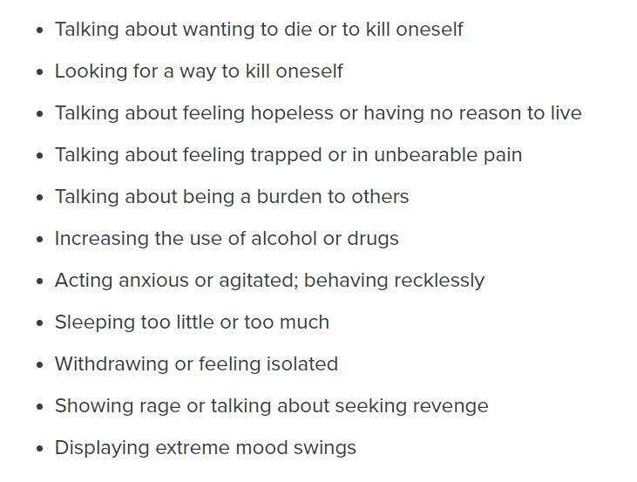
Warning Signs of Suicide
If someone you know is showing one or more of the following behaviors, he or she may be thinking about suicide. Don’t ignore these warning signs. Get help immediately.

Slide 25
If you think someone is in immediate danger, do not leave him or her alone—stay there and call 113.

Slide 26
ACTIVITY
Objectives:
Identify the difference between occasional negative emotions and more serious mental health issues, such as anxiety disorder or depression
Explore practices for ensuring mental health and emotional balance in your life
Identify resources for further information and guidance about mental health issues
Directions:
Watch the following Tedx Talk, featuring college student Jack Park. In this talk, Jack shares his story of living with a mental disorder and revisits some of the ways he found help and hope. He makes the case for seeing mental illness in a new light, so that people can begin to address some of the issues associated with suicide, depression, and other preventable mental disorders.

Slide 27


